Slide 1


Strategies for controlling head-tail connectivity in olefin-olefin cross couplings
Frederik Simonsen Bro
Postdoctoral researcher
Supervisor: Asst. Prof. Sebastian Clementson
Clementson group meeting
Research presentation
2026.06.18
Notes:
A more subject-based presentation instead of a specific paper.

Slide 2
Head and tail nomenclature
EWG = electron-withdrawing group

Slide 3
Tail-to-tail (polar)
B. B. Snider, D. J. Rodini, J. van Straten, J. Am. Chem. Soc., 1980, 102, 5872-5880.
Notes:
Can imagine you can hydrogenated to get to the saturated compound.

Slide 4
Tail-to-tail (polar) – mechanism
B. B. Snider, D. J. Rodini, J. van Straten, J. Am. Chem. Soc., 1980, 102, 5872-5880.
Notes:
Regioselectivity: Olefin attacks to give most stable carbocation. 1,4-addition is favoured since olefins are soft nucleophiles and direct addition is reversible and conjugate is not.

Slide 5
Tail-to-tail (radical) 1
H. C. Brown, G. W. Kabalka, J. Am. Chem. Soc., 1970, 92, 714-716.

Slide 6
Tail-to-tail (radical) 1 – mechanism
C. Ollivier, P. Renaud, Chem. Rev., 2001, 101, 3415-3434.
Notes:
Regioselectvity: Brown hydroboration occurs with anti-Markovnikov selectivity where boron adds to the least hindered (substituted) carbon. Electron-deficient olefin most electrophilic at the tail.

Slide 7
Tail-to-tail (radical) 2
Q. Zheng et al., ChemRxiv (preprint), 2026, DOI: 10.26434/chemrxiv.15003501/v1.
EWG = electron-withdrawing group
LED = light-emitting diode
Notes:
Very similar, but radical is formed via photocatalysis.

Slide 8
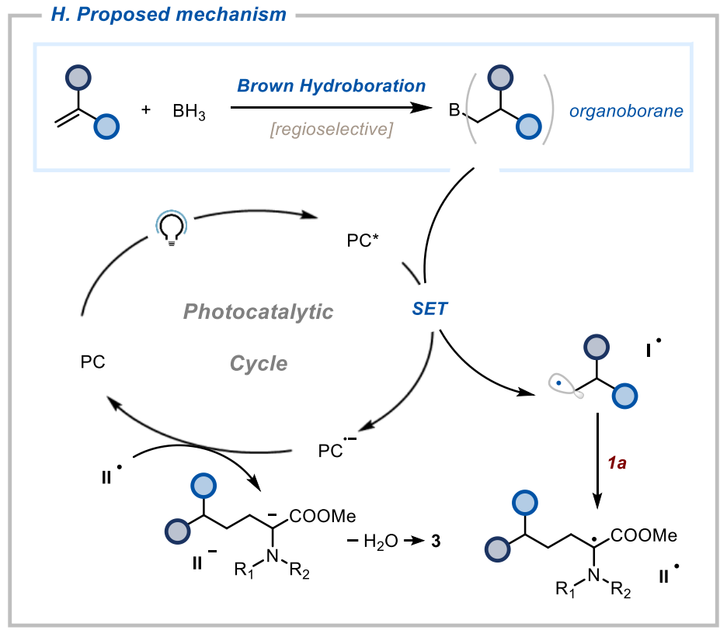
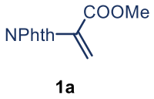
Tail-to-tail (radical) 2 – mechanism
Q. Zheng et al., ChemRxiv (preprint), 2026, DOI: 10.26434/chemrxiv.15003501/v1.
PC = photocatalyst
SET = single electron transfer
Notes:
Regioselectvity: Brown hydroboration occurs with anti-Markovnikov selectivity where boron adds to the least hindered (substituted) carbon. Electron-deficient olefin most electrophilic at the tail.

Slide 9
Head-to-tail
J. C. Lo, Y. Yabe, P. S. Baran, J. Am. Chem. Soc., 2014, 136, 1304-1307; J. C. Lo et al., J. Am. Chem. Soc., 2017, 139, 2484-2503.
EWG = electron-withdrawing group
EG = ethylene glycol
Notes:
Very general, many different olefins and electron-deficient olefins and both inter- and intramolecular.

Slide 10
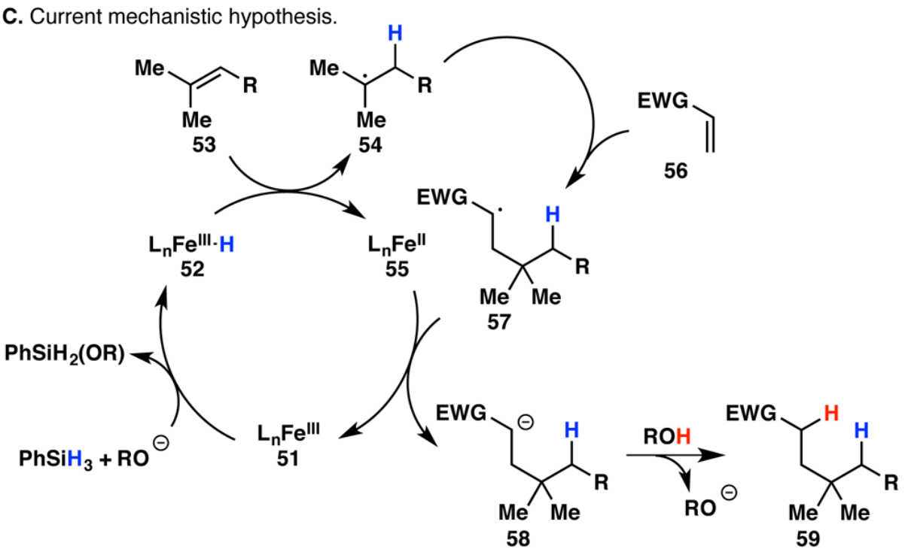
Head-to-tail – mechanism (simplified)
J. C. Lo, Y. Yabe, P. S. Baran, J. Am. Chem. Soc., 2014, 136, 1304-1307; J. C. Lo et al., J. Am. Chem. Soc., 2017, 139, 2484-2503.
EWG = electron-withdrawing group
Notes:
Regioselectivity: Most stable radical forms (at the head) in the MHAT. Electron-deficient olefin most electrophilic at the tail.

Slide 11
Tail-to-head
W. Zhou, I. A. Dmitriev, P. Melchiorre, J. Am. Chem. Soc., 2023, 25098-25102.
DCE = 1,2-dichloroethane
EWG = electron-withdrawing group
LED = light-emitting diode

Slide 12
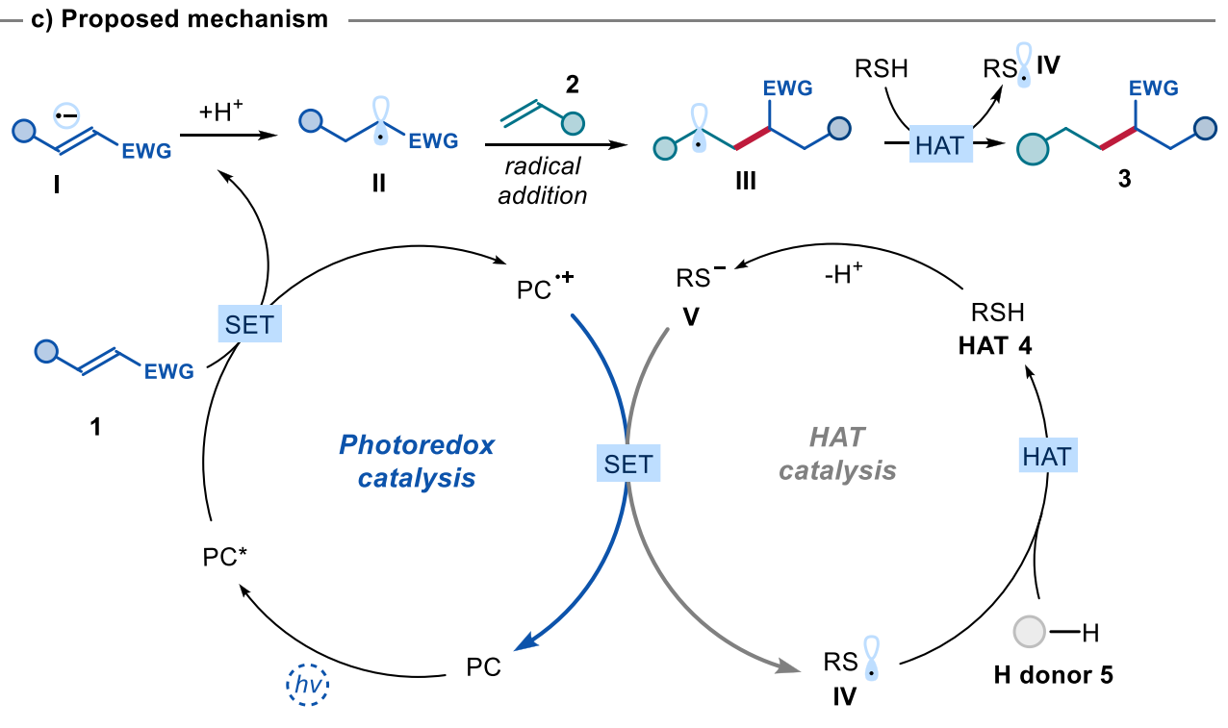
Tail-to-head – mechanism
W. Zhou, I. A. Dmitriev, P. Melchiorre, J. Am. Chem. Soc., 2023, 25098-25102.
EWG = electron-withdrawing group
HAT = hydrogen atom transfer
PC = photocatalyst
SET = single electron transfer
Notes:
Regioselectivity: Most stable radical forms after SET and protonation, as well as addition to radical.

Slide 13
Quiz – question 1
J. C. Lo, Y. Yabe, P. S. Baran, J. Am. Chem. Soc., 2014, 136, 1304-1307; J. C. Lo et al., J. Am. Chem. Soc., 2017, 139, 2484-2503.
MHAT = metal-hydride
hydrogen atom transfer
Notes:
What’s the product?
It is a head-to-tail process.
What about the stereochemistry?
cis-Decalin formed due to the tether. Easier to attack from bottom face of the enone where it does not have to bend and twist – kinetically favoured.

Slide 14
Quiz – question 2
PC = photocatalyst
SET = single electron transfer
DCE = 1,2-dichloroethane
LED = light-emitting diode
Notes:
What’s the conditions?
It is a tail-to-head process.
What about the stereochemistry?
Stereochemistry: Attack from top face of olefin due to tether to put hydrogen and methyl on the same face. Will probably give a mixture of diastereoisomers at the isopropyl substituent since one TS is not favoured. One is endo-equatorial and the other is exo-axial.

Slide 15
Quiz – question 3
B. B. Snider, D. J. Rodini, J. van Straten, J. Am. Chem. Soc., 1980, 102, 5872-5880; S. Y. W. Lau, Org. Lett., 2011, 13, 347-349.
Notes:
What’s the product?
It is a tail-to-tail process.
What about the stereochemistry?
cis-Decalin formed due to the tether. Easier to attack from bottom face of the enone where it does not have to bend and twist – kinetically favoured. Isopropyl ends up on top face initially since it can adopt convex-pseudoequatorial in the TS. However, two hydride transfer were the last one can only occur across the convex face due to orbital overlap puts the isopropyl on the bottom concave face. Hydrogenation occurs from the convex face to give cis fusion.

Slide 16
Quiz – question 3 (continued)
J. C. Lo, Y. Yabe, P. S. Baran, J. Am. Chem. Soc., 2014, 136, 1304-1307; Q. Lin et al., Org. Lett., 2022, 24, 8459-8464.
Notes:
Baran reported that if you use a very Lewis acidic iron catalyst you get tail-to-tail regioselectvity via Michael-Prins cyclisation.
Cation quenched with water instead of hydride transfer thus keeping the initial stereochemistry with isopropyl on top convex face.
Deoxygenation using reported conditions for tertiary alcohol (this is hypothesised) could give the other diastereoisomer.

Slide 17
Quiz – question 3 (continued)
EWG = electron-withdrawing group
LED = light-emitting diode
PC = photocatalyst
Notes:
Same product expected with the radical tail-to-tail conditions.

Slide 18
Quiz – question 4
MHAT = metal-hydride hydrogen atom transfer
SET = single electron transfer
Notes:
Haven’t been able to find conditions for the head-to-head process.
Could you combine MHAT with photoredox via radical-radical cross coupling?

Slide 19
Conclusion
✅
✅
✅
❌
Notes:
We can control the head-tail connectivity of olefin-olefin cross couplings by choosing the right conditions. Head-to-head still to be discovered.

Slide 20

Thank you for your attention!

